Slide 1
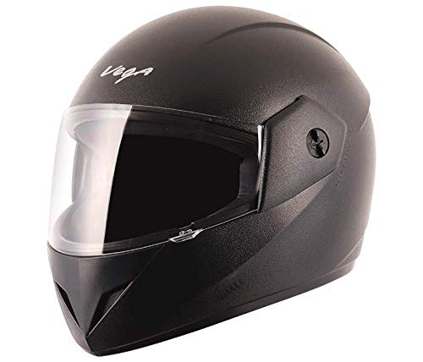

Smart Helmet
Modern Problems Require Modern Solutions

Slide 2
Agenda
Smart Helmet
01
Recap of the Project
We will be providing you with the recap of our project decided last semester.
02
Actual Working Prototype
Today we are going to show you, how are we going to implement our idea in a small scale
03
Requirements
We are also going to tell you are our requirements.
04
Budget
Presenting our Project Budget

Slide 3
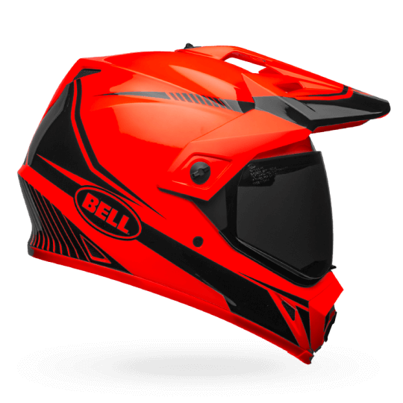
Brief idea
Motivation
Nowadays the numbers of road accidents are increasing at a fast rate. In every minute, 17 persons are killed due to road accidents. And a major part of these road accidents occur due to over speeding and drunk driving. The major victims to the road accidents are the two wheeler drivers because since they are driving an open vehicle there is no protection of any kind for them.
Our Idea
Hence we have decided to build a SMART HELMET for the safety of the bikers. This helmet warns the driver if he is drunk and over speeding. And still the biker does not agree to its warnings then it automatically switches off the ignition tank.
99%
80%
Motivation Clarity
Ideation Clarity

Slide 4
Innovativeness and Uniqueness
“What is now Proved
was Once only
Imagined”
Flexible design
Since we have a warning system, the design is flexible and preferred to use
Cost effective
Since it is not expensive many people would buy it.
Open Code
Since we have made our code open, it is viable to change according to locations
Basic Design
Due to basic design no complicated connections have been made.
Safety Factor
Our Helmet is going to provide safety to drivers and the family members won’t need to worry about them.

Slide 5
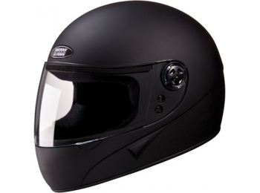
Implementation in Small Scale
What are we going to do
In a bicycle, we are going to control the brakes of the bicycle and show how our prototype is going to work.
Working with Bike
01
I hope and I believe that this Template will your Time.
Implementation
IDEA
Working with Bicycle
What was our Idea?
02
We are going to work with bicycle and make our prototype for bicycle..
In Bike we were going to control the fuel tank and accordingly by turning off the tank the bike would have stopped.

Slide 6
Timeline of Our Working
Starting on field work
Testing and improving
We are going to start our work with integrating all the sensors and parts.
We would test how efficient is our prototype and make according changes
29 Jan
8 Feb
22 Feb
29 Feb
8 March
Ordering of Parts
Ending the work
Final Working model
We are going to order all the sensors and instruments from Amazon
It’s expected that two weeks are needed for the completion of this project.
Presenting our Final Working Model

Slide 7
Our Requirements
Money
Tools from Labs
Money is an important requirement for making this project
We need machines and tools from our labs to work with.
80%
20%

Slide 8
Budget
Microcontrollers
Rs.4314
Arduino(x6)
Wireless transcievers(x6)
Sensors
Rs.1095
Gas Sensor(x3)
Hall Effect Sensor(x3)
Other Parts
Rs.1600
Battery(x15)
LEDs(x6)
Buzzers(x3)
Dc Motors(x2)
BreadBoard(x5)
Total
7,009

Slide 9
Follow Our Progress
Our Progress
Our codes
You can follow our progress by visiting our Git Hub Repository.
All our codes would be uploaded on it.
Git hub Repository
https://github.com/vedthakur5/Smart-Helmet

Slide 10
Thank You

